Slide 1
Analysis of ECG using AI

Slide 2
What is an ECG?

Slide 3
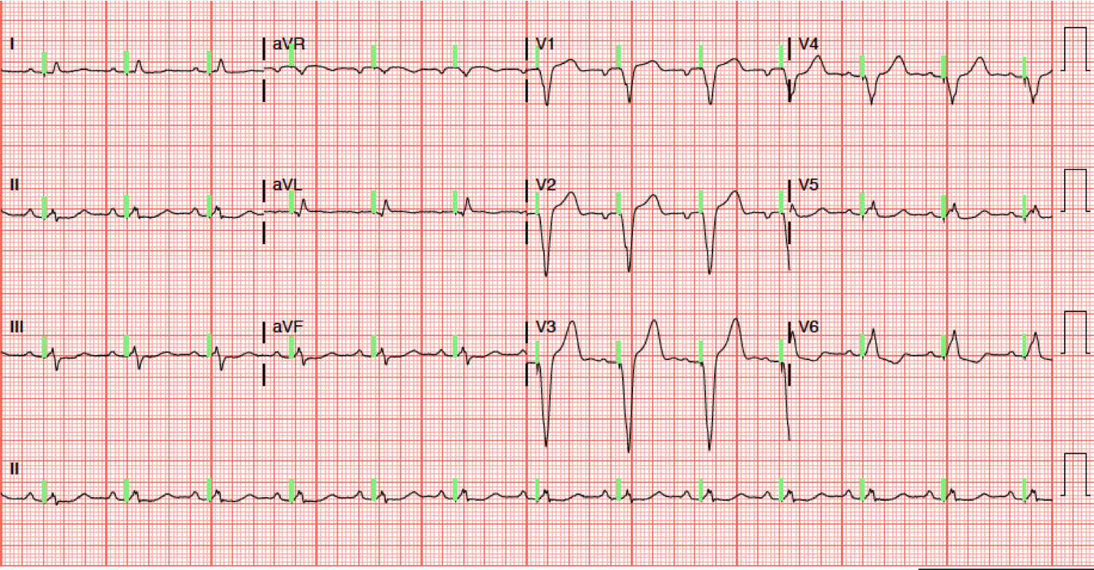
It is the process of producing electrocardiogram

Slide 4
What is an electrocardiogram?

Slide 5
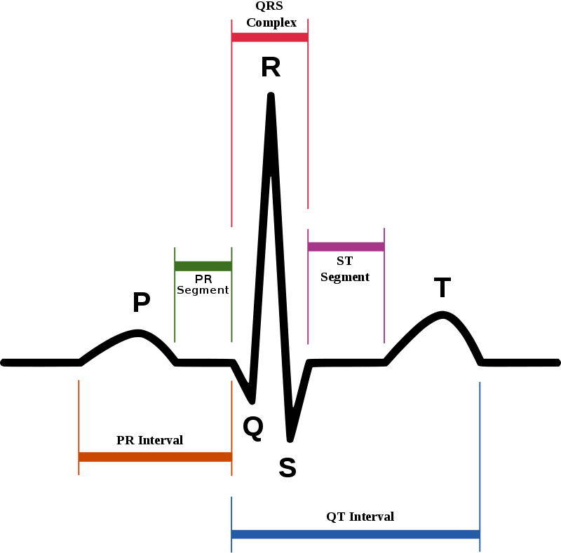
Electric activity of the heart
Plotted as a time vs. voltage graph

Slide 6
How is it useful?

Slide 7

Diagnosis of heart conditions
cardiac rhythm disturbances
inadequate coronary artery blood flow
electrolyte disturbances

Slide 8
Scope of our project

Slide 9


Convert discrete signals into visualizable graphs
Classify the heart conditions according to the test data
Aid medical personnels in diagnosis

Slide 10
Beyond the scope of our project

Slide 11
Our aim is not to
Undermine medical experts
Provide medical advice
Interpret the implications of our result

Slide 12
The Technical Aspect

Slide 13
The Data of ECG

Slide 14
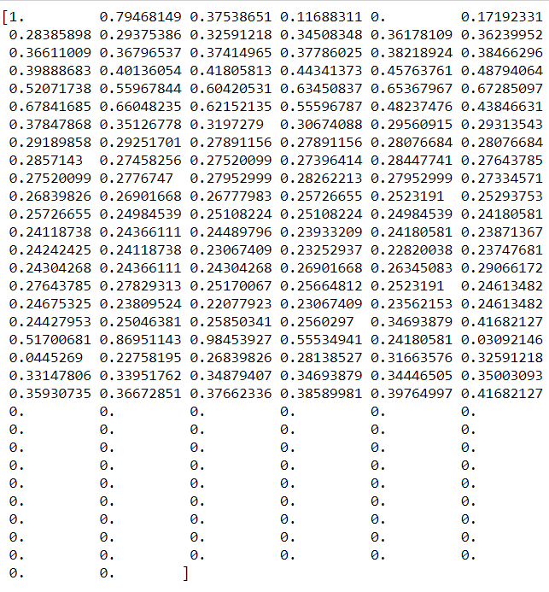
Labelled data^{[1]} is given in coordinates form, by sampling the ECG
[1] Data taken from Kaggle repository
https://www.kaggle.com/shayanfazeli/heartbeat

Slide 15
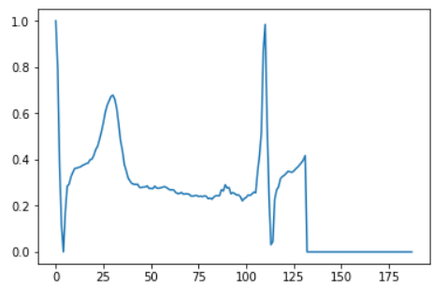
Which can be back plotted to form ecg as:

Slide 16
Supervised Learning to classify normal and abnormal heartbeats

Slide 17
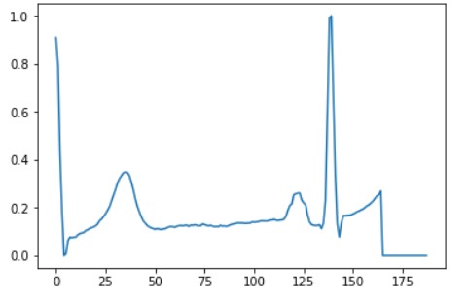
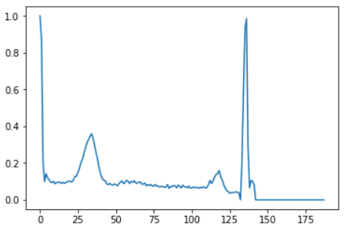
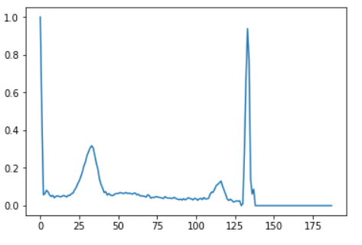
Sample of normal Heart Beats

Slide 18
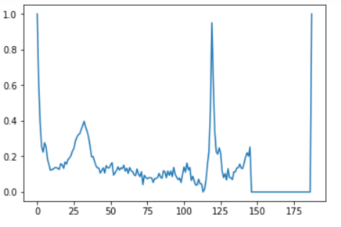
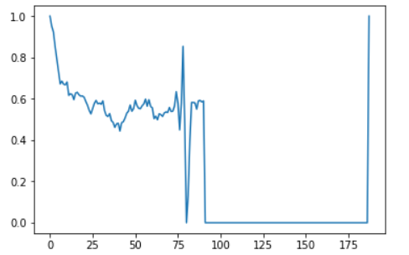
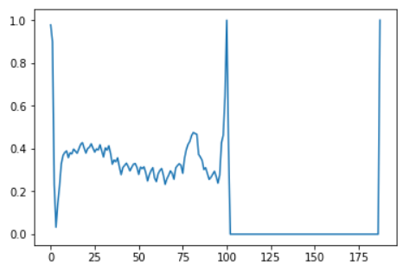
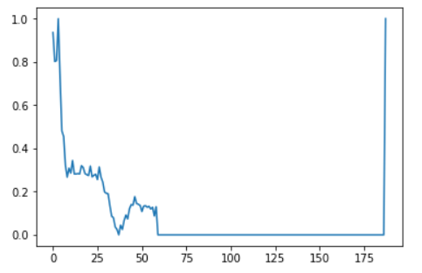
Sample of abnormal Heart Beats

Slide 19
Algorithms to Implement

Slide 20
Classification Algorithms as
Random Forest
SVM

